Slide 1
DIY Smart Home Automation
Projects HomeLamps, BlynkLamps and VideoSockConnection
https://github.com/PavelKanazirev/Esp32

Slide 2
Projects comparison
HomeLamps
BlynkLamps
Distributed Security
https://github.com/PavelKanazirev/Esp32/tree/master/HomeLamps
ESP32 with a remote WiFi interface – allowing dynamic setting and command execution ( including Microphone sensor, Relays and LCD display )
https://github.com/PavelKanazirev/Esp32/tree/master/BlynkLamps
Blynk application running on Android – allowing dynamic settings and command execution ( includes Temperature and Humidity sensor, LCD replication )
https://github.com/PavelKanazirev/Esp32/tree/master/VideoSockConnectionTest
JAVA application running on a remote PC with access to the USB camera streaming through the Raspberry Pi and activating the alarm buzzer on the ESP32 using the HTTP protocol

Slide 3
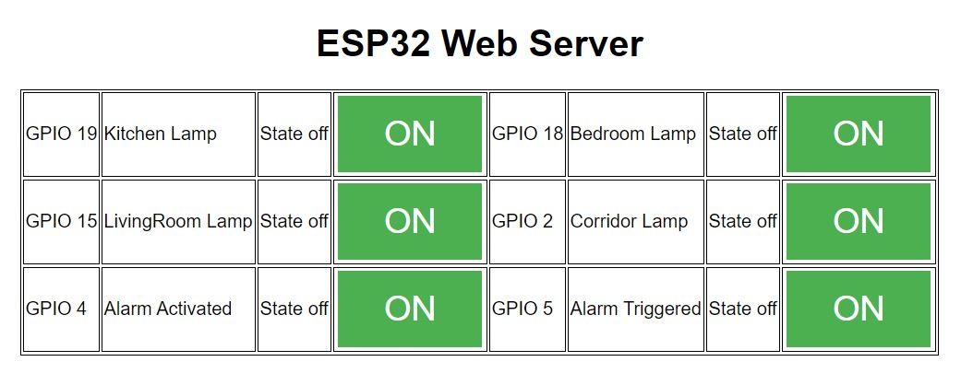
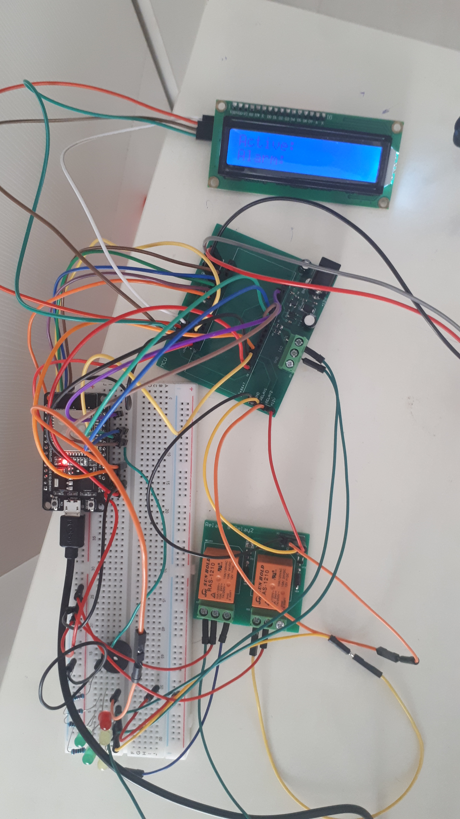
HomeLamps

Slide 4
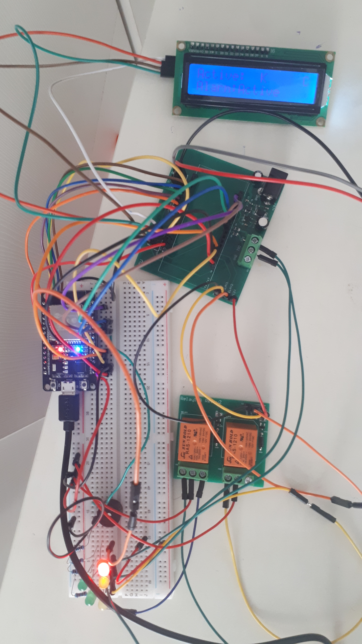
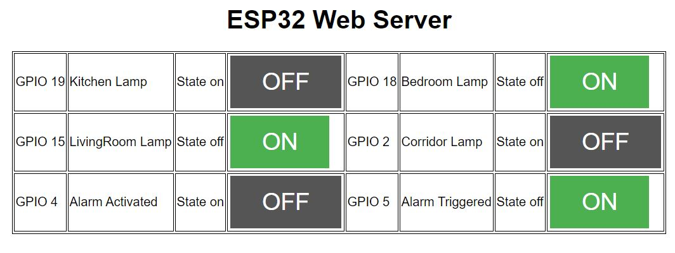
LCD is synchronized with the actuator states as requested by the HTTP interface including the Alarm state
When the Alarm is activated – the microphone is active – monitoring the noise. Whenever the noise goes above certain value ( through reverse engineering the value 80 [from 0 to 1023] was chosen ) the Alarm gets triggered and the Buzzer starts beeping.

Slide 5
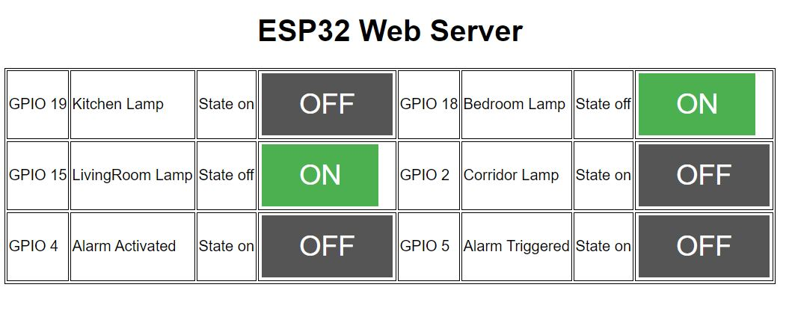
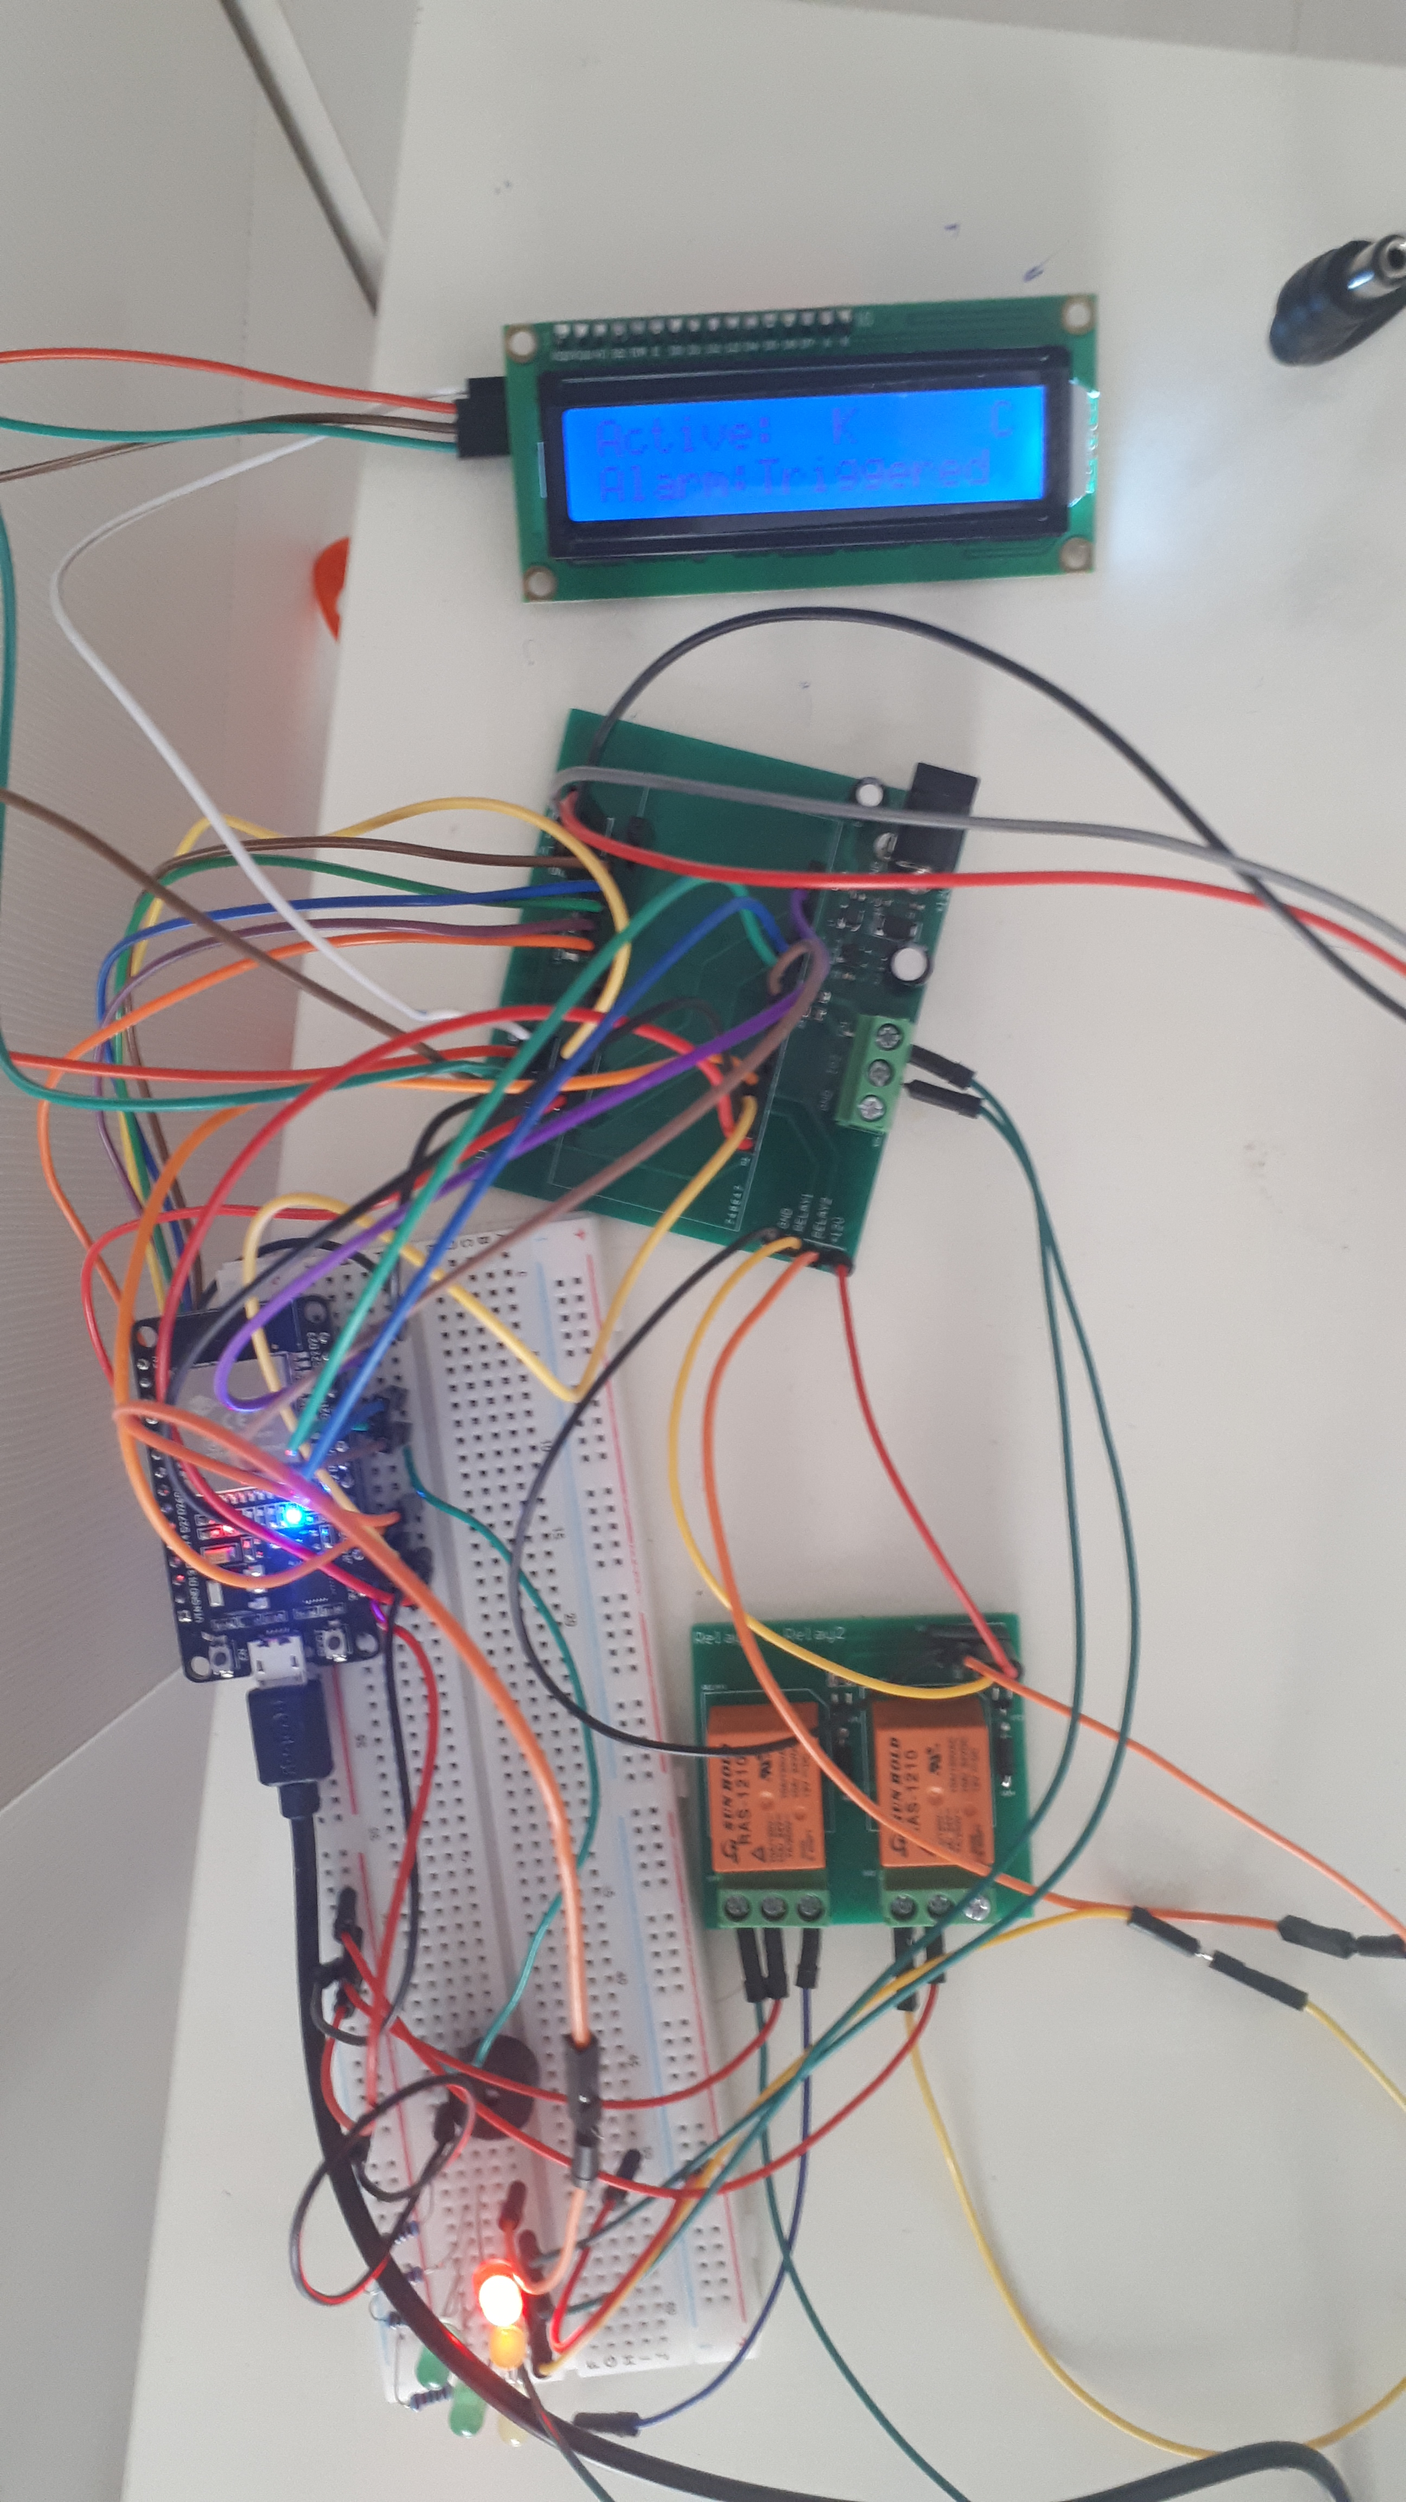
LCD is synchronized with the actuator states as requested by the HTTP interface including the Alarm state
When the Alarm is activated – the microphone is active – monitoring the noise. Whenever the noise goes above certain value ( through reverse engineering the value 80 [from 0 to 1023] was chosen ) the Alarm gets triggered and the Buzzer starts beeping. As a separate use case – if the Alarm Activated was not set to “State on” – no matter what the microphone is detecting – the alarm is not Triggered.

Slide 6
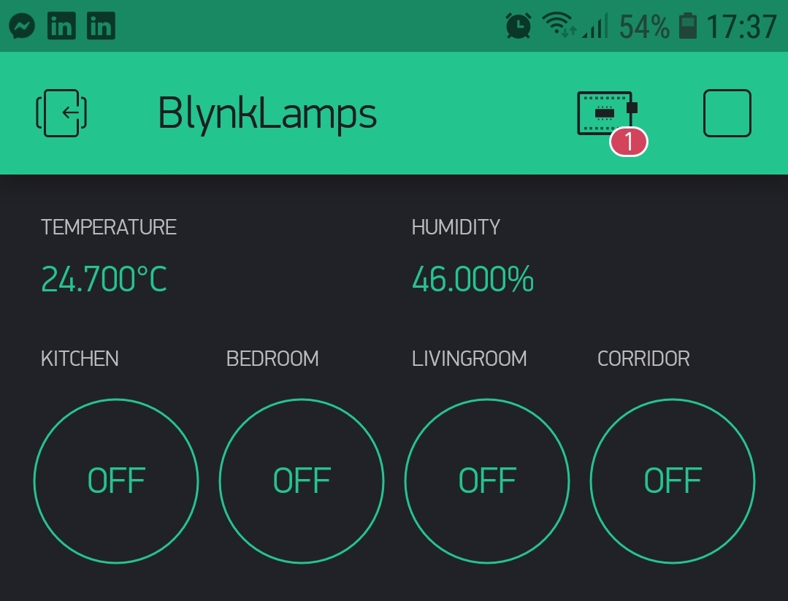
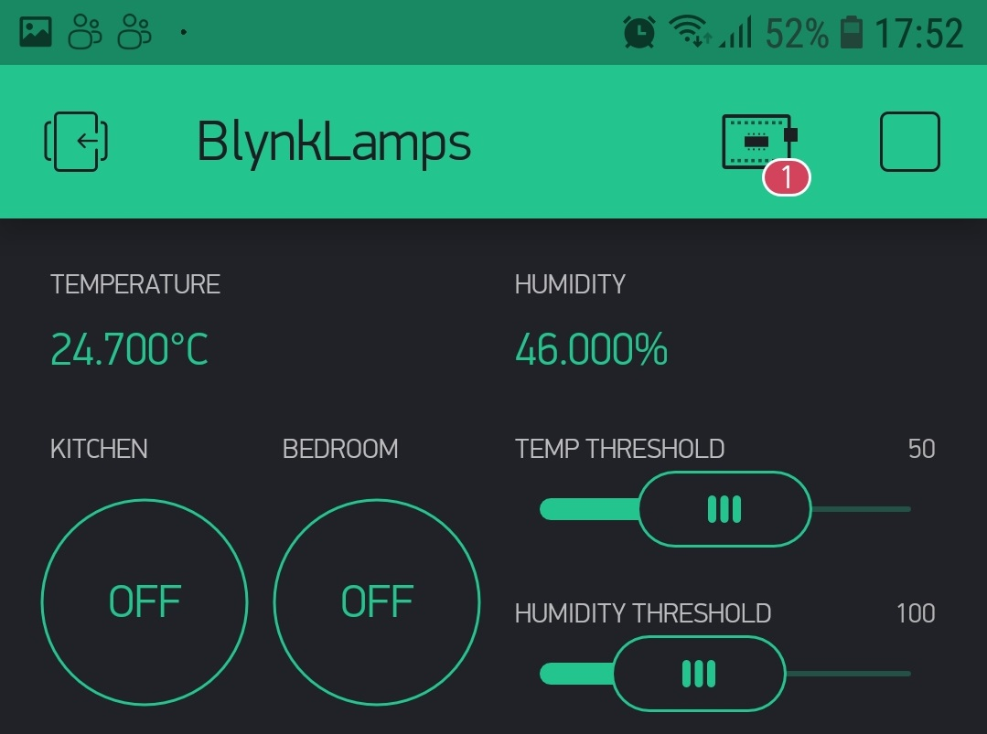
BlynkLamps
System configuration similar to the one from the previous project. Main difference in the peripherals is that instead of a microphone – we have a DHT – temperature and humidity sensor.
Again the device can be controlled remotely – but this time – not with the HTTP protocol – but with the Android OS – Blynk app. Prerequisite is – an authorization key to be received for this project and for this device by the company implementing the Blynk application.

Slide 7
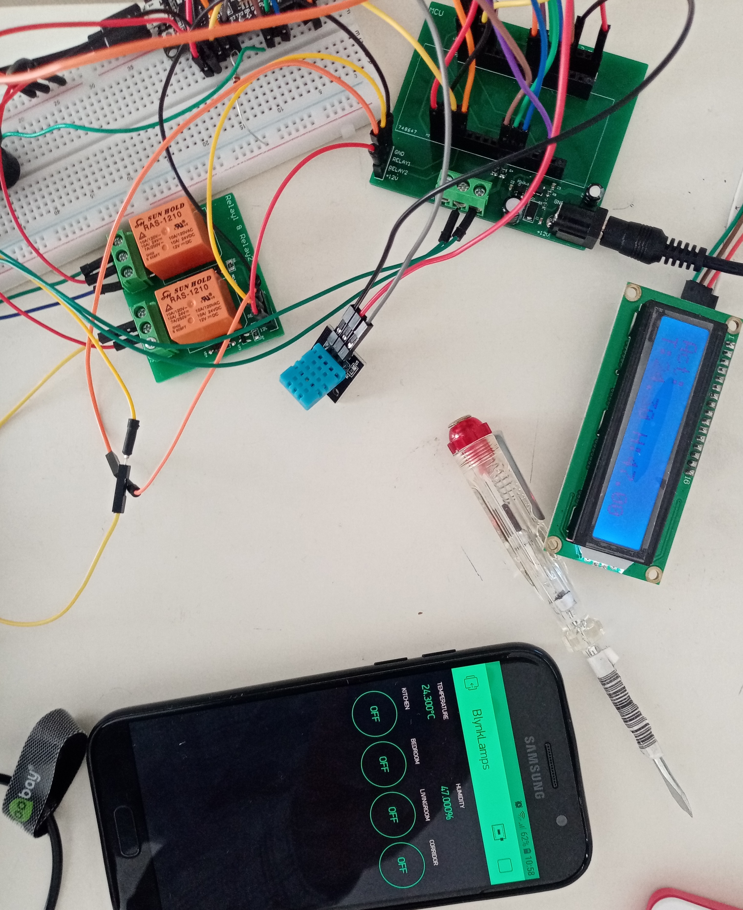
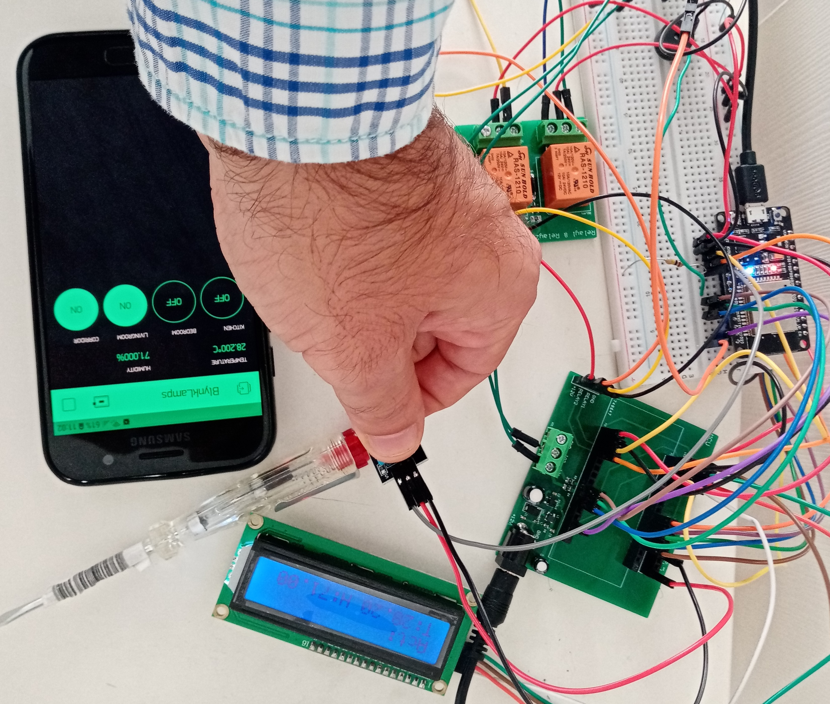
Temperature test
Temperature starts from 24.30 ang goes
up to 28.20 degrees Celsius

Slide 8
On certain time period – the temperature and the humidity values are checked against the remotely configured values.
If one of the values goes beyond the one that is set using the Blynk slider – the buzzer goes On simulating an alarm no matter if the alarm has been activated or not.
There is a constraint of the free version of the Blynk – approximately 6 widgets are allowed to be used in one project.

Slide 9
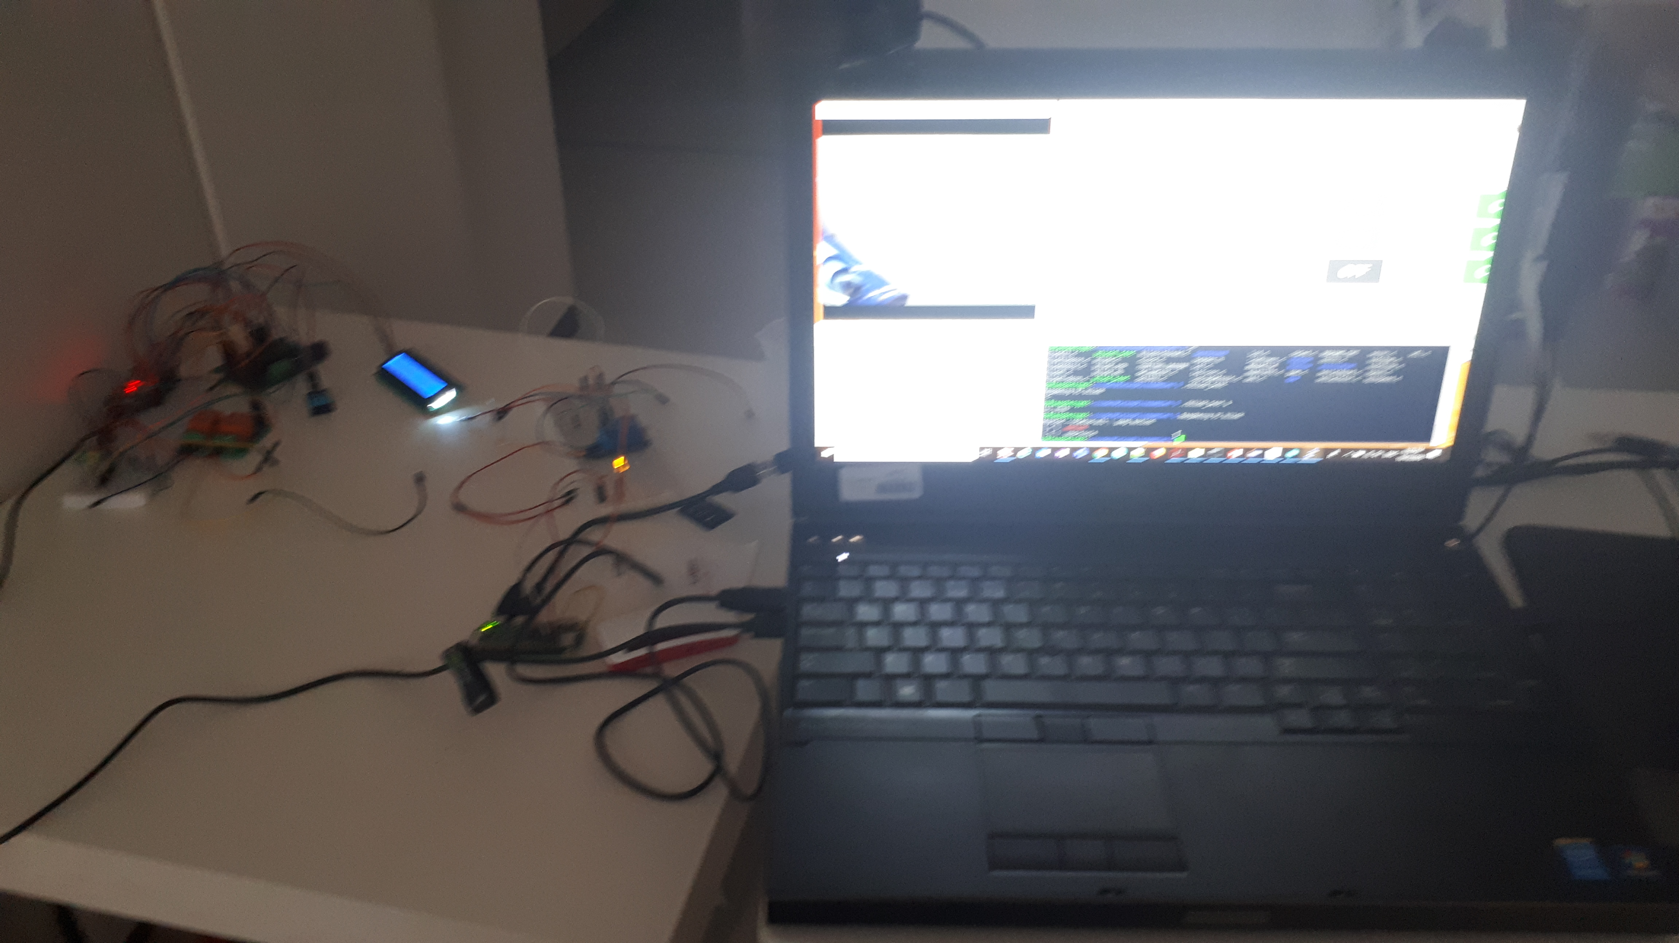
Distributed Security System
Additional indicators
USB camera
ESP32 with a
Buzzer and
HTTP server
LCD display
Showing the
Status in the
Monitored
room
Desktop with JAVA running the motion detection engine
Raspberry PI transmitting the video stream from the USB camera to an external port

Slide 10
System mechanical / hardware decomposition
ESP32
RaspberryPi
Java desktop
Performs its own monitoring – measures noise, temperature, humidity and activates the alarm if needed by making the results visible on port 80 by using the HTTP protocol. Provides an ability to the desktop application to trigger the alarm directly if a motion is detected after analyzing the video frames received.
Turns some peripherals indicating the usb camera is capturing frames. Provides video stream on port 8081 – visible for the external devices.
Used as a machine with much more computing power. Stores the latest two frames received from the Raspberry’s port and detects if there has been a motion or not. If a motion is detected – first checks if the alarm is in state activated ( by parsing the content of the HTTP response ). If the alarm state is activated – it forces the ESP32 to beep the buzzer – triggering the alarm.

Slide 11
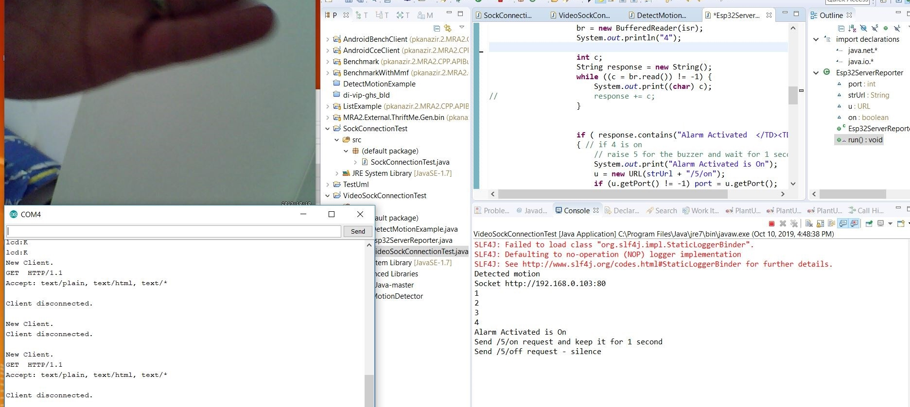
The alarm is activated – motion is detected
Signal /5/on is sent directly from the Java code to the port 80 of the ESP device. After that the code waits for 1 second and sends a new command /5/off in order to stop the buzzer until a new motion is detected.

Slide 12
Feel more secure now?
Thanks!

